Slide 1
Coursera Capstone Project
IBM Applied Data Science Capstone
Opening a New Yoga Centre in Toronto City, Canada
by Susan Das

Slide 2
Business Problem
The objective of this capstone project is to find the most suitable location for the entrepreneur to open a new Yoga Studio in the city of Toronto, Canada.
Business Requirement : If an entrepreneur wants to open a Yoga Studio in Toronto city in that case which location in Toronto city should he/she optimally consider focusing business competition and future growth.

Slide 3
Data Requirements
List of neighbourhoods of Toronto, Canada
Latitude and Longitude of the neighbourhoods
Venue data related to existing Yoga Studios in Toronto for final model input and comparison study.

Slide 4
Data Collections
Scrapping of Toronto neighbourhoods from Wikipedia link i.e. https://en.wikipedia.org/wiki/List_of_postal_codes_of_Canada:_M
Getting Latitude and Longitude data of these neighbourhoods via Geocoder package
Using Foursquare API to get venue data related to these neighbourhoods

Slide 5
Methodology
Web scraping Wikipedia page for Toronto neighbourhoods
Get latitude and longitude coordinates using Geocoder
Use Foursquare API to get venue data
Group data by neighbourhood and taking the mean of the frequency of occurrence of each venue category
Filter venue category by “Yoga Studio”
Perform unsupervised ML algo i.e. Clustering on the data by using k-means clustering
Visualize the clusters in a map using Folium

Slide 6
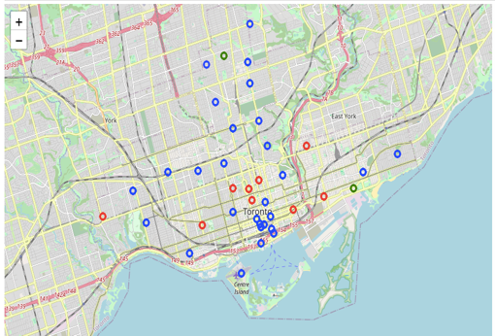
Result
The results from k-means clustering show that we can categorize Toronto neighbourhoods into 3 clusters based on how many Yoga Studios are situated at each neighbourhood
Cluster 0 : Neighbourhoods having most numbers of Yoga Studios i.e. ten studios
Cluster 1 : Neighbourhoods having only one Yoga Studio
Cluster 2 : Neighbourhoods having only two Yoga Studios

Slide 7
Recommendations
Among three clusters, cluster 0 having most of the Yoga Studios i.e. around 10. Only 2 studios are present under cluster 2 and only 1 studio is present under cluster 1.
Near North Toronto West, Lawrence Park and South Toronto, having only 2 studios. There are good opportunities to open new one around this area i.e. cluster 2.
Also near Stn A PO neighbourhood , only one studio is available. It looks cluster 1 might also be a good location to setup a new Yoga Studio.
We can have the conclusion for this project and recommends to the entrepreneur to open a new Yoga Studio in the above mentioned locations.

Slide 8
Thank You !

